Slide 1
Chapter 1
Introduction

Slide 2
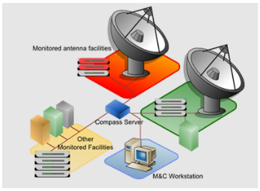

Slide 3
Communication
Communication – transfer of information from one point to another
Tele (Far) + Communications – by converting the info into electrical signals
Early telecommunications
smoke signals
Telegraph and telephone
Telegraph (1837) – Wheatstone & Morse (separately)
Telephone (1876) – Alexander Bell
Radio and television
Telephony
Voice and Data

Slide 4
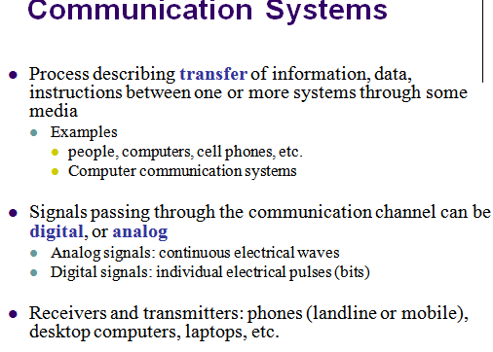

Slide 5
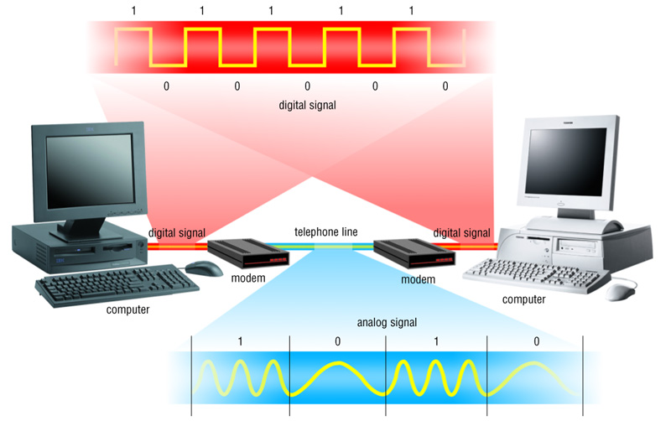
Communication Systems

Slide 6


Slide 7
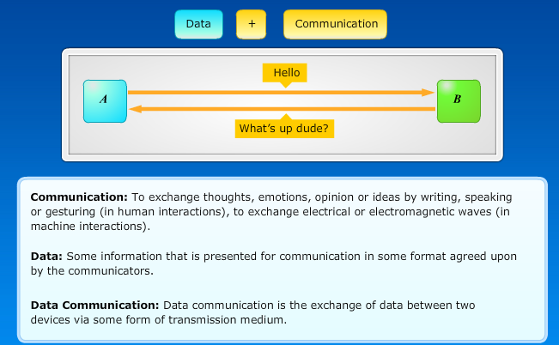

Slide 8
DATA COMMUNICATIONS
The term telecommunication means communication at a distance. The word data refers to information presented in whatever form is agreed upon by the parties creating and using the data. Data communications are the exchange of data between two devices via some form of transmission medium such as a wire cable.
Topics discussed in this section:
Components
Data Representation Data Flow

Slide 9
Data communication system is made up a
Combination of
Hardware (physical equipment) And
Software (programs)
Data communication system has Five (5) Components
Three Hardware and Two Software

Slide 10
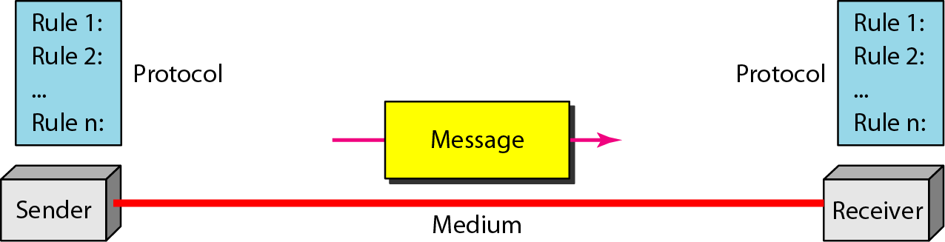
Five components of data communication

Slide 11
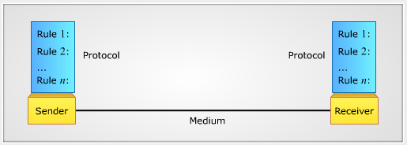
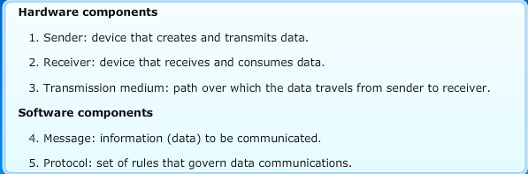

Slide 13
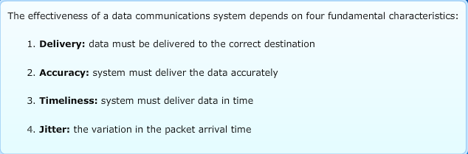

Slide 15
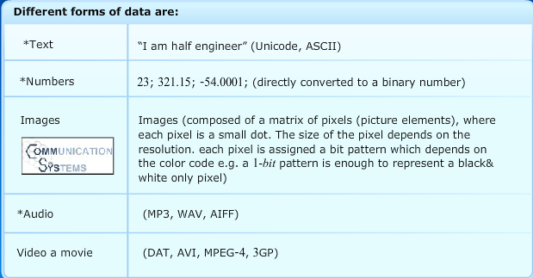

Slide 16
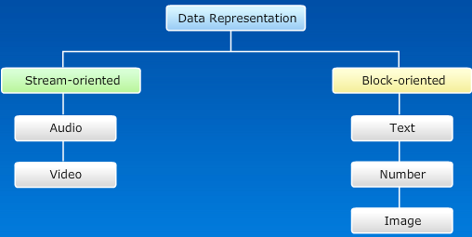

Slide 18



Slide 19
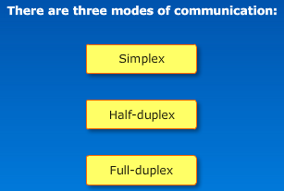

Slide 20
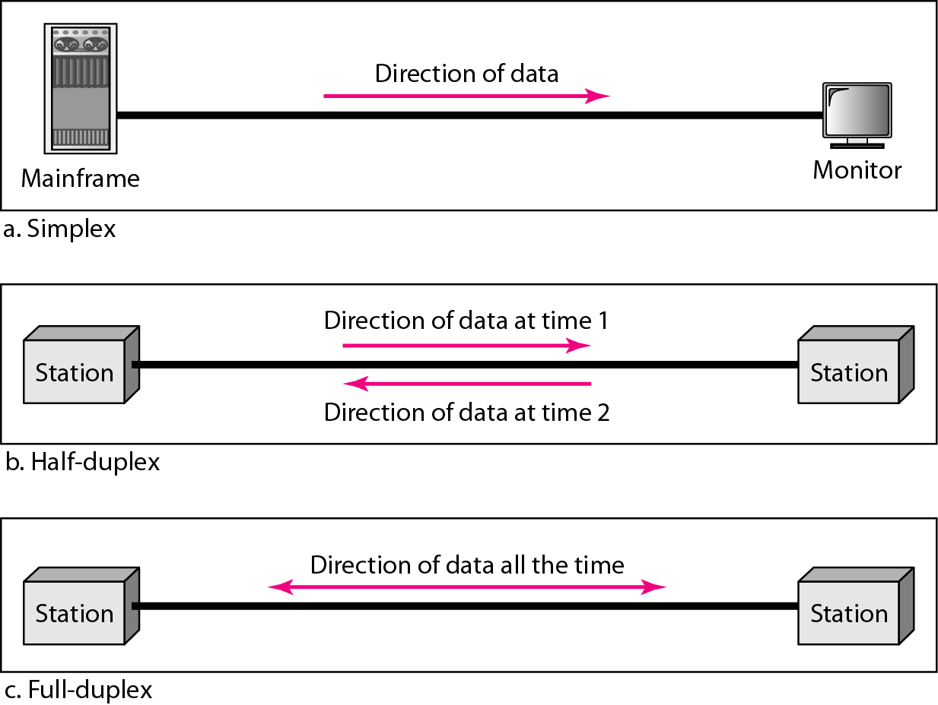
Figure 1.2 Data flow (simplex, half-duplex, and full-duplex)

Slide 21
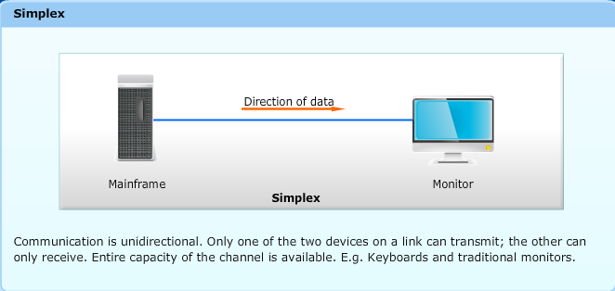

Slide 22
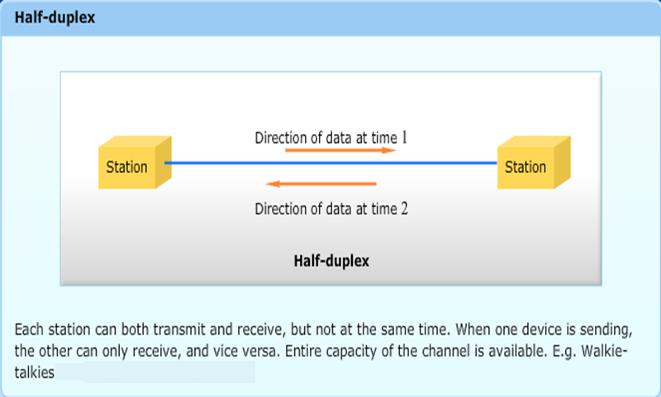

Slide 23
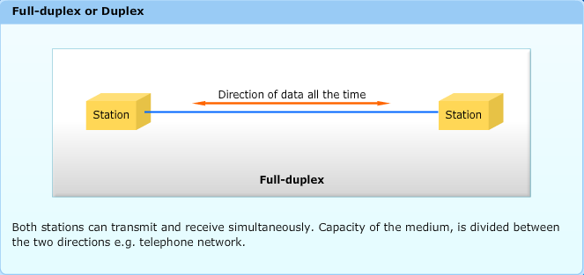

Slide 24
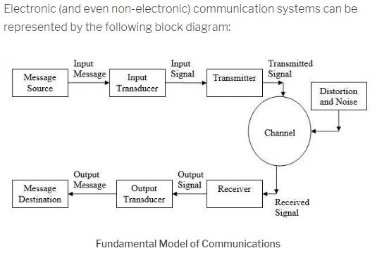

Slide 25
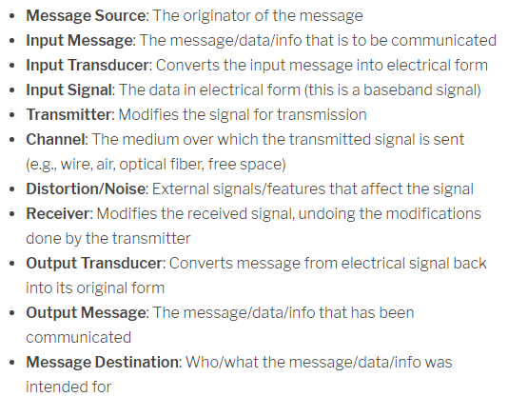

Slide 26
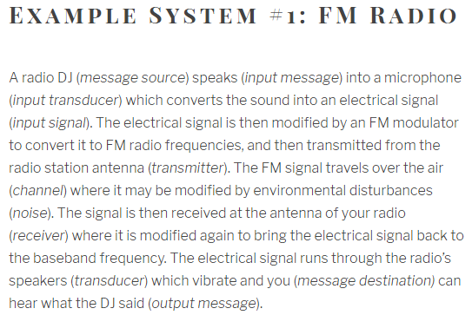

Slide 27
PROTOCOLS
A protocol is synonymous with rule. It consists of a set of rules that govern data communications. It determines what is communicated, how it is communicated and when it is communicated. The key elements of a protocol are syntax, semantics and timing
Topics discussed in this section:
Syntax
Semantics
Timing

Slide 28
Elements of a Protocol
Syntax
Structure or format of the data
Indicates how to read the bits - field delineation
Semantics
Interprets the meaning of the bits
Knows which fields define what action
Timing
When data should be sent and what
Speed at which data should be sent or speed at which it is being received.

Slide 30
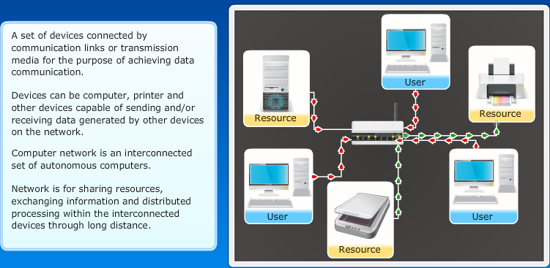

Slide 31
Data and Signals

Slide 32

Note
To be transmitted, data must be transformed to electromagnetic signals.

Slide 33
ANALOG AND DIGITAL
Data can be analog or digital. The term analog data refers to information that is continuous; digital data refers to information that has discrete states. Analog data take on continuous values. Digital data take on discrete values.
Topics discussed in this section:
Analog and Digital Data
Analog and Digital Signals
Periodic and Nonperiodic Signals

Slide 34
Analog and Digital Data
Data can be analog or digital.
Analog data are continuous and take continuous values.
Digital data have discrete states and take discrete values.

Slide 35
Analog and Digital Signals
Signals can be analog or digital.
Analog signals can have an infinite number of values in a range.
Digital signals can have only a limited number of values.

Slide 36
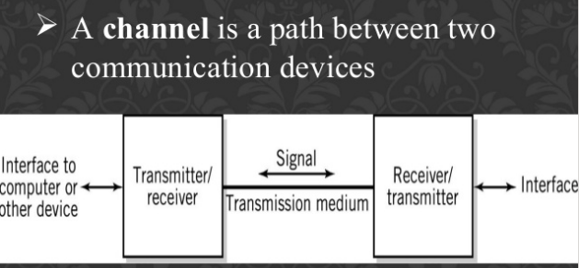

Slide 37
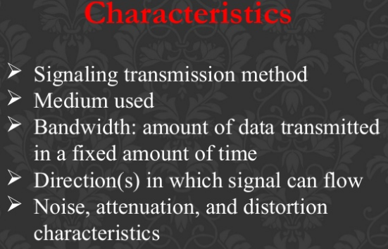

Slide 38
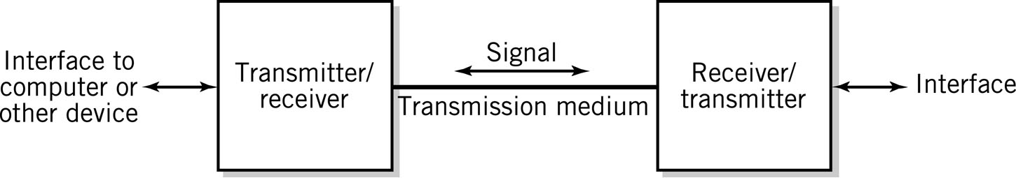
Communication Channel

Slide 39
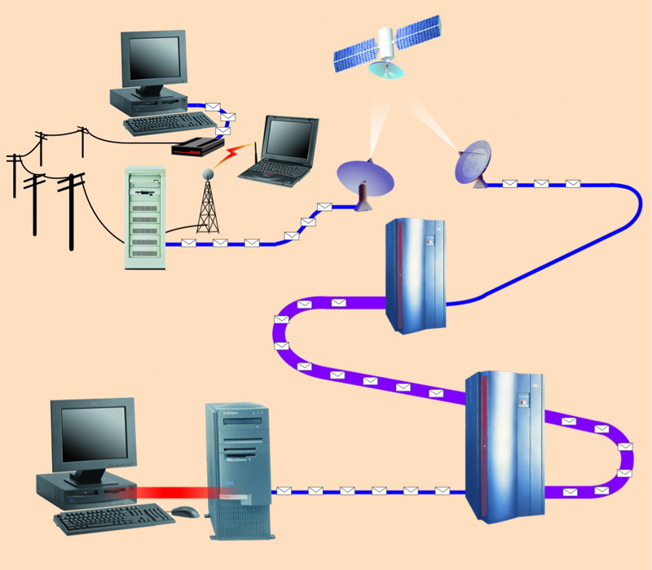
Communication Channels
A channel is a path between two communication devices
Channel capacity: How much data can be passed through the channel (bit/sec)
Also called channel bandwidth
The smaller the pipe the slower data transfer!
Consists of one or more transmission media
Materials carrying the signal
Two types:
Physical: wire cable
Wireless: Air
T1 lines
T1 lines
destination network server
T3 lines
T1 lines

Slide 40
Communication Channel
Characterized by
Signaling transmission method
Bandwidth: amount of data transmitted in a fixed amount of time
Direction(s) in which signal can flow
Noise, attenuation, and distortion characteristics
Medium used

Slide 41
Signaling Transmission Method
Analog: continuous varying waveforms to carry data
Digital:
Two different values of electrical voltage or current or
On/off light source
Frequently preferred because less susceptible to noise and interference

Slide 42
Channel Organization
Point to point channels
Simplex: channel passes data in one direction only
Half-duplex: transmits data one direction at a time (walkie-talkie)
Full-duplex: transmits data in both directions simultaneously (telephone)
Multipoint: broadcasts messages to all connected receivers

Slide 43
Communicating between Digital and Analog
Ideally conversion should be reversible
Limited by
Noise: interference from sources like radio waves, electrical wires, and bad connections that alter the data
Attenuation: normal reduction in signal strength during transmission caused by the transmission medium
Distortion: alteration in the data signal caused by the communication channel

Slide 44
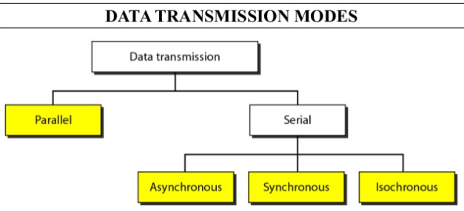

Slide 45
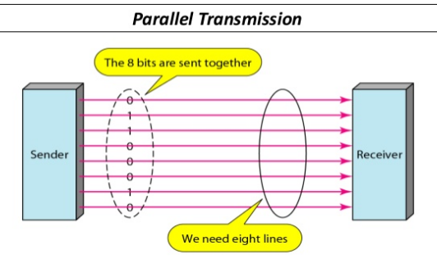


Slide 46
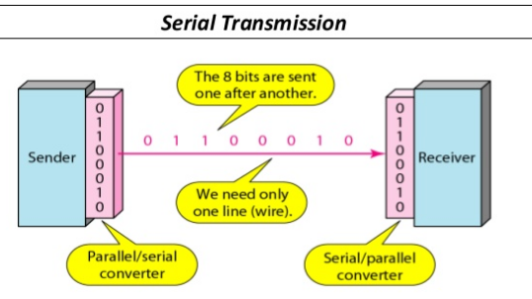


Slide 47
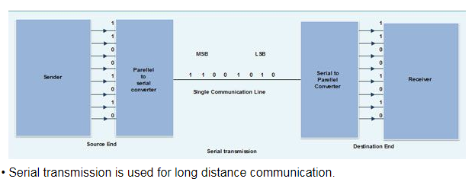

Slide 48
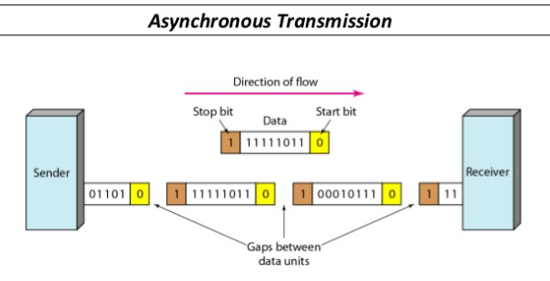


Slide 49
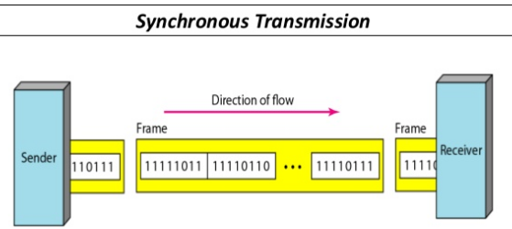
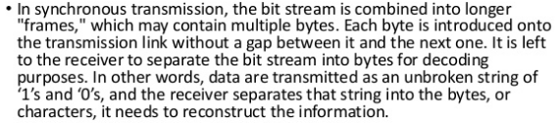

Slide 50
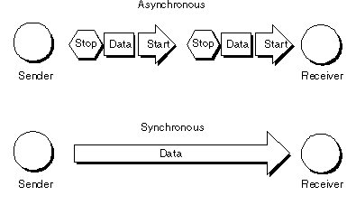

Slide 51
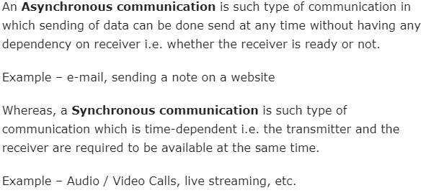

Slide 52
